Slide 1
FIPRONIL-PLUS-C Fipronil 0.65% With Cellulose entrapment technology
ARIZONA CHEMICAL GROUP LLC

Slide 2
FIPRONIL-Plus-C
Fipronil 0.65% a.i.
Cellulose Entrapment Technology
Provides a vehicle to apply pesticides in a safer and more effective way.
CAUTION signal word
Labeled for Indoor and Outdoor Use
Reduced Toxicity

Slide 3
SDS Toxicology Comparison
OTHER Fipronil Formulations
Fipronil Plus C
Hazards Classification - Health Hazards – NONE - Physical Hazards – NONE
Environmental Hazards – Marine pollutant
LD50
Oral > 5,000 mg/kg
Dermal > 5,000 mg/kg
Inhalation > 5.08 mg/L
Eye Irritation – minimal
Skin Irritation – slight
Skin Sensitization – No
Hazards Identification - Acute Oral – 4 Acute Inhalation – 4 Eye Irritation – 2B Skin Irritation – 2
Environmental Hazards – Marine Pollutant
LD50
Oral 1,999 mg/kg
Dermal >2,000 mg/kg
Inhalation >1.7 mg/L
Eye Irritation – slight
Skin Irritation – slight
Skin Sensitization - No

Slide 4
R&D INDUSTRY SUPPORT
University Involvement and support
Regulatory Involvement and support
Studies
Lab Results

Slide 5
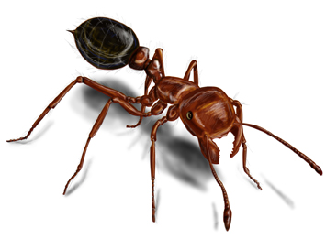
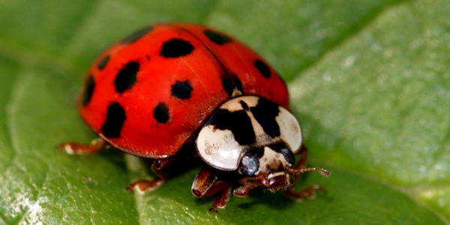
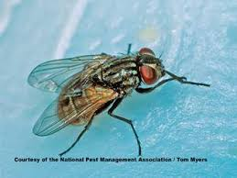
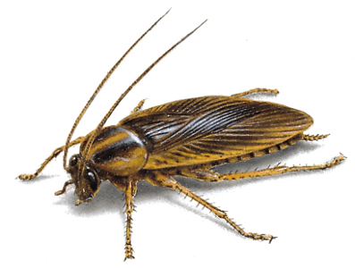
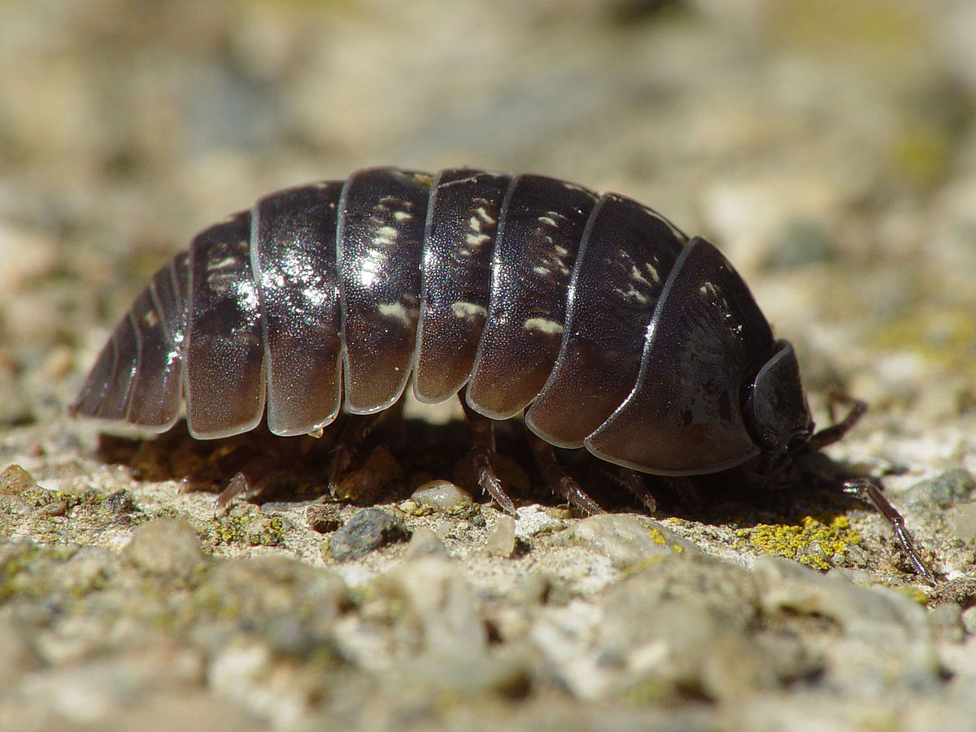
LISTED PESTS
Ants and Fire Ants (excluding Carpenter and Pharaoh Ants),
Asian Lady Beetles
Boxelder Bugs
Brown Marmorated Stink Bugs
German Cockroaches
Crickets, Earwigs,
House Flies
Pillbugs
Spiders (excluding Brown Recluse)

Slide 6
USE AREAS – Indoor & OUTDOOR USE in the Following structures:
Apartments,
Campground Structures,
Transportation Equipment (Buses, Cargo Trucks, Trailers, and Trains),
Homes,
Hospitals and Nursing Homes, Hotels,
Motels,
Office Buildings,
Food/Feed Areas of Restaurants,
Other Food Handling Establishments, and
Food Manufacturing Facilities,
Military/Government Buildings,
Schools,
Warehouses
Other Commercial and Industrial Buildings

Slide 7
USE RATES
1.5 fl oz (45.4 ml)
dilute in one gal of water
active ingredient concentration is equivalent to 0.0076% Fipronil
recommended for severe pest infestation
0.25 fl oz (7.5 ml)
dilute in one gal of water
active ingredient concentration is equivalent to 0.0013% Fipronil
recommended for maintenance treatments
0.75 fl oz (22.7 ml)
dilute in one gal of water
active ingredient concentration is equivalent to 0.0038% Fipronil
recommended for initial service or clean out treatments

Slide 8
STATE REGISTRATIONS
Massachusetts
Mississippi
Wisconsin
Iowa
Rhode Island
Alabama
Arkansas
Arizona
Florida
Georgia
Hawaii
Idaho
Illinois
Indiana
Kansas
Kentucky
Louisiana
Michigan
Missouri
Nevada
New Mexico
New York
North Carolina
New Hampshire
Ohio
Oklahoma
Oregon
Pennsylvania
South Carolina
Tennessee
Texas
Utah
Virginia
Washington
Delaware
Maine
New Jersey
Maryland

Slide 9
TESTIMONIALS
“Plain and simple, this product WORKS!! Fipronil-Plus-C is a non-repellent insecticide that can be applied to the exterior of buildings and structures as well as an interior application, with NO ODOR. I love this product when dealing with difficult to control ants – especially fire ants. One application – zero budding – zero retreats.”
Jessica C.
Magic Pest Control
The potential benefits of cellulose entrapment technology to the people and environment of the United States are enormous. This particular cellulose entrapment technology maintains or increases the efficacy of conventional active ingredients at lower application rates than used for conventional pesticides without cellulose, while at the same time reducing risk and increased safety to the applicator, the property owner, and the environment. These benefits have been demonstrated by chemical analysis, scanning electronmicrographs, and bioassays.
George Rotramel PhD,
Rotramel Technical Service

Slide 10
TESTIMONIALS
“I have used this product and have seen the results. It is one of the best products I have used on the market today, within 3-5 days all Ants were gone. I have used other products were the Ants have just moved from place to place however Fipronil-Plus -C has shown me they did not just move; they died !!!!... I recommend the use of this product if you are having issues with ants. thank you
Wesley. S
Spray Plus Pest Control.
“I have been doing pest control for over 45 years and I have had the opportunity to use Fipronil-Plus-C from last September on fire ants ,cockroaches, spiders, crickets and stink bugs Fipronil plus-C reminds me of the old time products when you sprayed the bugs they were dead and you had very few call backs. I have applied this product at all three use rates with great success on all rates: less call backs, longer lasting with lower toxicity. I recommend Fipronil-Plus–C to all my colleagues in the pest control industry. you will be glad you tried it.”
-BOB Fahnholz,
A-1 Pest, Phoenix AZ

Slide 11
FIPRONIL-PLUS-C
Labeled for Indoor & Outdoor Use.
Safer to use
Innovative Cellulose Technology
Effective at lower use rates
Less Call backs
More bang for your buck

